Slide 1
Paralympics and Sport rehabilitation
Academic Year 2024-2025
08.04.2025

Slide 2

Pressure - sensitive MAT + air chamber cushion
Amari Giacomo | 10698309
Milazzo Alessandro Giuseppe | 10766415
Traversi Gloria | 10816956
Usai Chiara | 11005835
Zanoni Chiara | 10784594
08.04.2025
25.03.2025
Focus group
Proposal
Focus group
Proposal
Conclusion

Slide 3



Partecipants
ANDREA
DAVIDE
ALESSANDRO
‘ci ha restituito un pezzo di vita’
Focus group
Proposal
Conclusion

Slide 4
Partecipants
ANDREA
Experience: various races
Issues: safety, comfort, upper limbs, outdoor
Purpose: use with families and friends
DAVIDE
Experience: various races
Issues: transporting the trike, customization, comfort, safety, outdoor
Purpose: autonomous training
ALESSANDRO
Experience: training
Issues: safety, comfort, upper limbs, outdoor
Purpose: total body training
Focus group
Proposal
Conclusion

Slide 5
Partecipants
ANDREA
Experience: various races
Issues: safety, comfort, upper limbs, outdoor
Purpose: use with families and friends
DAVIDE
Experience: various races
Issues: transporting the trike, customization, comfort, safety, outdoor
Purpose: autonomous training
ALESSANDRO
Experience: training
Issues: safety, comfort, upper limbs, outdoor
Purpose: total body training
Focus group
Proposal
Conclusion

Slide 6
Partecipants
ANDREA
Experience: various races
Issues: safety, comfort, upper limbs, outdoor
Purpose: use with families and friends
DAVIDE
Experience: various races
Issues: transporting the trike, customization, comfort, safety, outdoor
Purpose: autonomous training
ALESSANDRO
Experience: training
Issues: safety, comfort, upper limbs, outdoor
Purpose: total body training
Focus group
Proposal
Conclusion

Slide 7
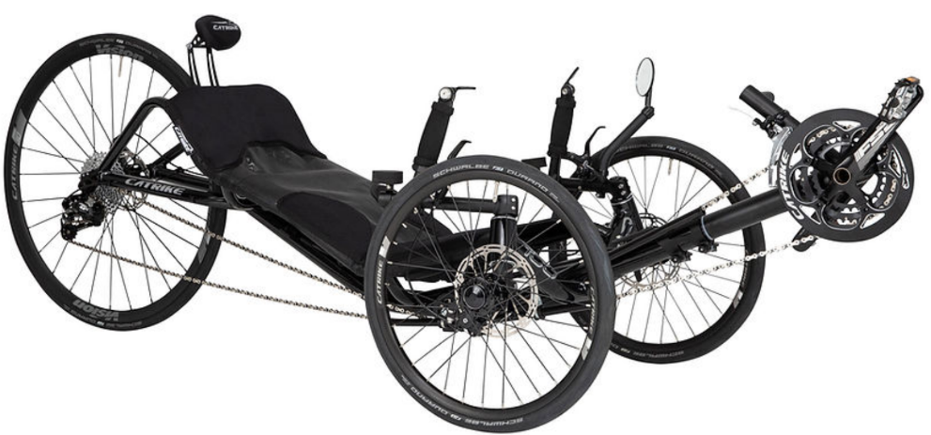


Critical issues
ANDREA
Experience: various races
Issues: safety, comfort, upper limbs, outdoor
Purpose: use with families and friends
DAVIDE
Experience: various races
Issues: transporting the trike, customization, comfort, safety, outdoor
Purpose: autonomous training
ALESSANDRO
Experience: training
Issues: safety, comfort, upper limbs, outdoor
Purpose: total body training
SAFETY
→ Decubitus ulcers
COMFORT
→ Ergonomic seat
Focus group
Proposal
Conclusion

Slide 8
SAFETY
→ Decubitus ulcers
COMFORT
→ Ergonomic seat
FUNCTIONAL REQUIREMENT
Description of the requirement: | Prevent further pressure sores Be comfortable Prevent unwanted movements (of the rider and the device) Be lightweight and NOT bulky Adaptable to the trike
Proposal
Focus group
Conclusion

Slide 9
Pressure-sensitive MAT + air chamber cushion
The independent cell cushion is designed to adjust the air within the chambers in response to pressure changes detected by the MAT, thereby reducing overload and enhancing load balancing.
Proposal
Conclusion

Slide 10


Pressure-sensitive MAT + air chamber cushion
CUSHION
PRESSURE SENSITIVE – MAT
MICROCONTROLLER
Proposal
Conclusion

Slide 11
Pressure-sensitive MAT + air chamber cushion
CUSHION
Adjustable cushion with separate air chambers for personalized support
PRESSURE SENSITIVE – MAT
MICROCONTROLLER
Proposal
Conclusion

Slide 12
Pressure-sensitive MAT + air chamber cushion
CUSHION
Material selection: hypoallergenic, breathable, non-slip, waterproof
Design optimization
PRESSURE SENSITIVE – MAT
MICROCONTROLLER
Proposal
Conclusion

Slide 13
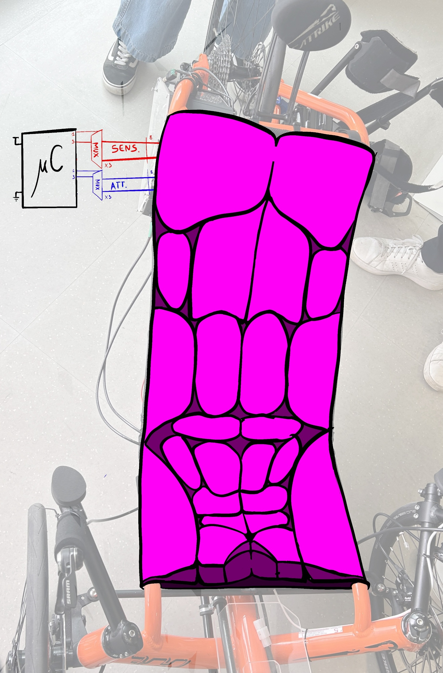
Pressure-sensitive MAT + air chamber cushion
PRESSURE SENSITIVE – MAT
Sensor-equipped mat that monitors pressure distribution in real time
MICROCONTROLLER
Proposal
Conclusion

Slide 14
Pressure-sensitive MAT + air chamber cushion
PRESSURE SENSITIVE – MAT
Sensor & system configuration:
type, number, positioning, techincal specifications
MICROCONTROLLER
Proposal
Conclusion

Slide 15
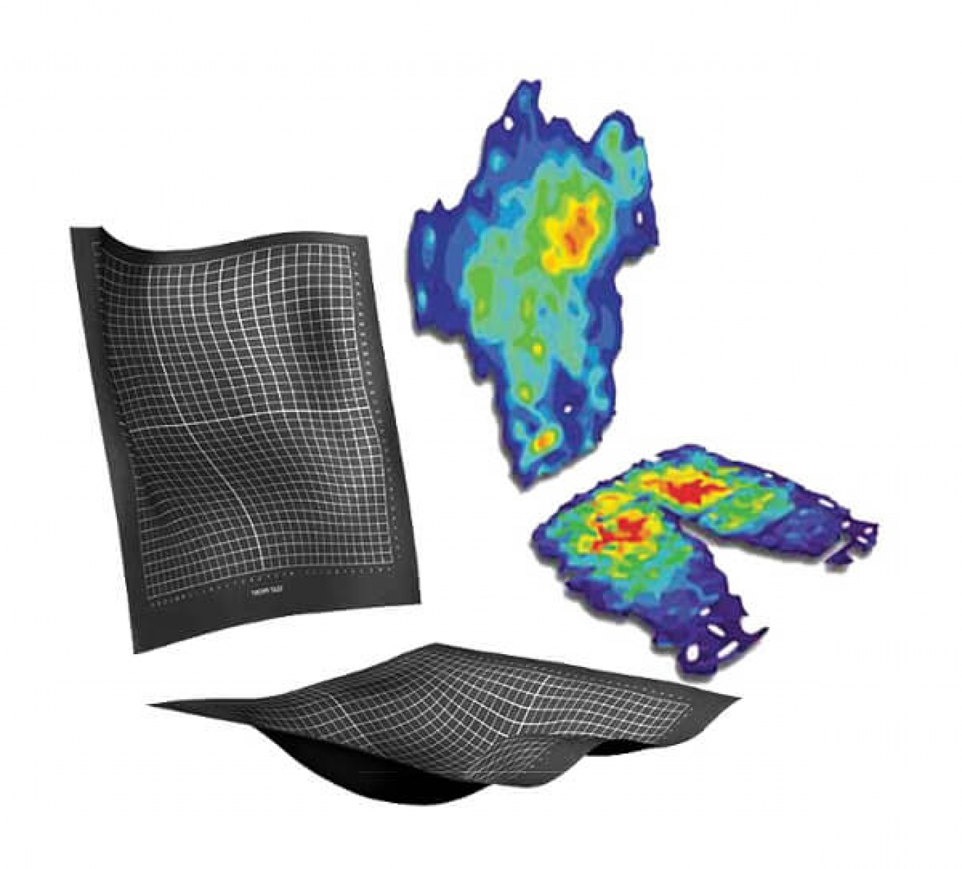
Pressure-sensitive MAT + air chamber cushion
MICROCONTROLLER
Integrated circuit that automatically regulates the pressure in the air chambers
Proposal
Conclusion

Slide 16
Pressure-sensitive MAT + air chamber cushion
MICROCONTROLLER
System configuration & control:
hardware and software
Proposal
Conclusion

Slide 17
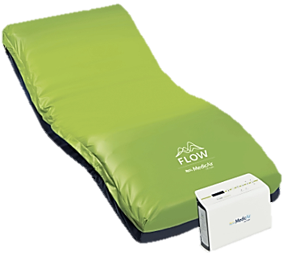
Conclusion
Aim: to provide a safer and more comfortable experience, allowing the user to focus
more on performance without
the fear of potential issues.
08.04.2025
25.03.2025
Focus group
Proposal
https://www.servicemed.it/prodotti/sistemi-antidecubito-attivi-ad-aria/flow-advance/
https://www.nurse24.it/dossier/wound-care/sistema-antidecubito-flow-advance-ad-altissimo-rischio.html
Conclusion
Focus group
Proposal

Slide 18
Paralympics and Sport rehabilitation
Academic Year 2024-2025
08.04.2025

